Slide 1

Home Assignment
Noam Bergman

Slide 2
Outline
Data examination
Solution approach
Block Diagram
The way to the results
Results: Curves
Confusion matrix, Specificity vs. Sensitivity, Accuracy
Analysis of FNs, FPs.
Visualization of computer features by PCA
Next steps
ViT summary

Slide 3
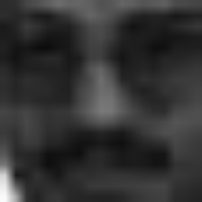
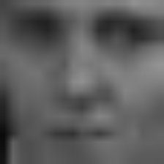
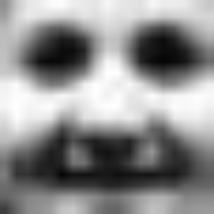
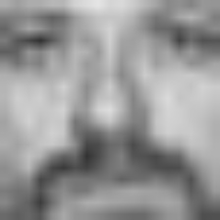
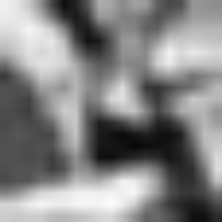
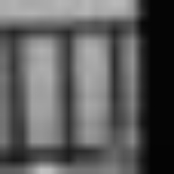
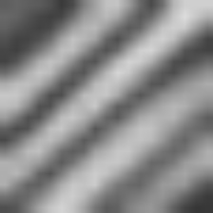
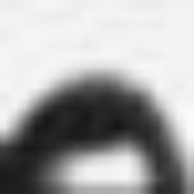
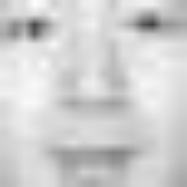
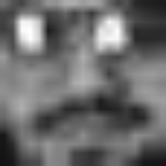
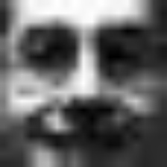
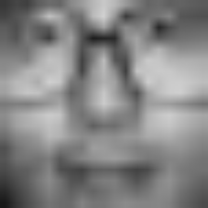
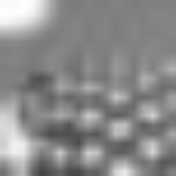
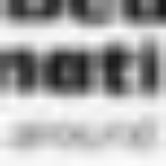
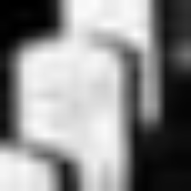
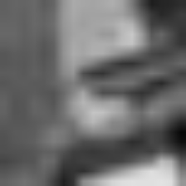
MIT Faces Dataset
Initial Steps:
Conversion to .jpg format.
Data inspection → both train and test set were resized to 224x224 for visual inspection.
CSV files were created with paths and labels.
Train set: 2429 faces (35%), 4548 non-faces (65%).
Test set: 472 faces (2%), 23573 non-faces (98%) → heavy imbalance.
Some positive examples from train set:
Some negative examples from train set:

Slide 4
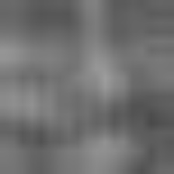
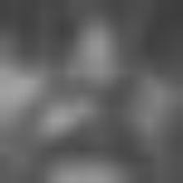
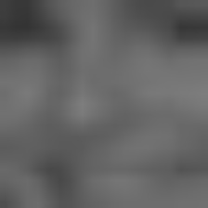
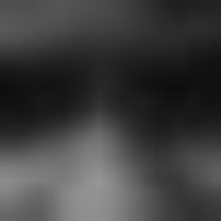
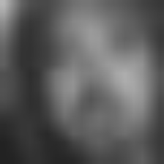
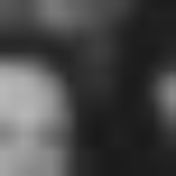
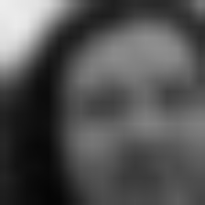
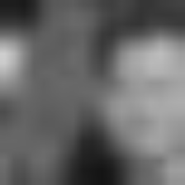
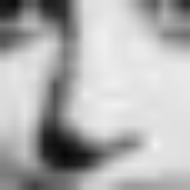

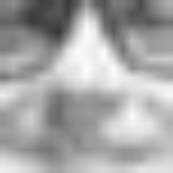
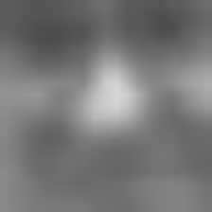
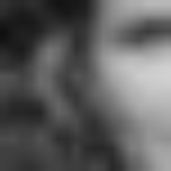
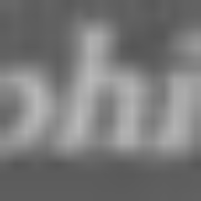
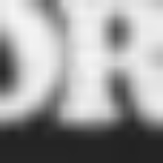
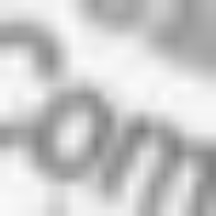
MIT Faces Dataset (Cont.)
Some positive examples from test set:
Some negative examples from test set:

Slide 5
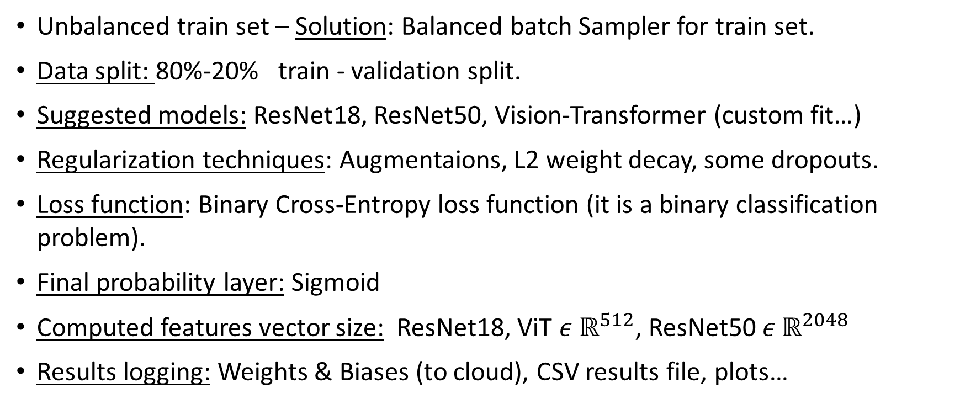
Solution approach
Unbalanced train set – Solution: Balanced batch Sampler for train set.
Data split: 80%-20% train - validation split.
Suggested models: ResNet18, ResNet50, Vision-Transformer (custom fit…)
Regularization techniques: Augmentaions, L2 weight decay, some dropouts.
Loss function: Binary Cross-Entropy loss function (it is a binary classification problem).
Final probability layer: Sigmoid
Computed features vector size: ResNet18, ViT $ε ℝ^{512}$, ResNet50 $ε ℝ^{2048}$
Results logging: Weights & Biases (to cloud), CSV results file, plots…

Slide 6
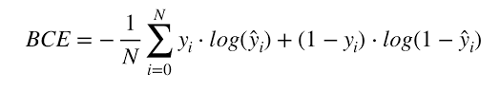
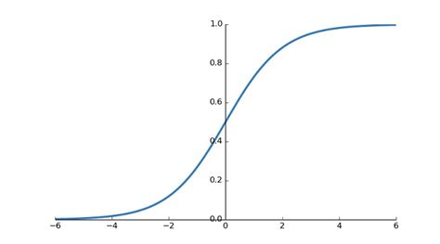
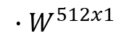
Block Diagram – ResNet18
Conv.1, 7x7
S=2,p=3
64
bn1
Relu
maxpool
Layer1 x2
20x20x3
10x10x64
5x5x64
5x5x64
logit
Layer2 x2
Layer3 x2
Layer4 x2
$${∙W}^{512x1}$$
1x1
3x3x128
2x2x256
Sigmoid
Features vector
1x1x512
Layer#:
Conv.1, 3x3
S=1,p=3
64
bn1
Relu
Conv.2, 7x7
S=2,p=3
64
bn2
+
Relu
5x5x64
5x5xX

Slide 7
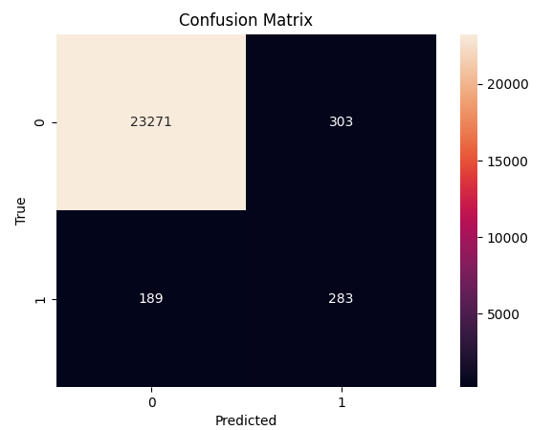
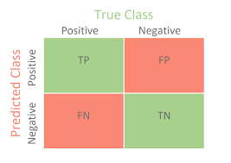
The way to the result
Initial step:
Train on ResNet18 with sigmoid and test results for 100 epochs and test results.
Not good enough – 189 FNs (40% of total positives) and 303 FPs.
Some thoughts:
Positives are rare in test-set → Let’s try not to miss any positive → Keep as few False Negatives as possible → maximize Recall/TPR. (TPR = TP / TP + FN).
What curves will emphasize the right information (or recall)?
1. Specificity – Sensitivity (TNR vs. TPR) curve (for all thresholds)
TNR = TN / TN + FP, TPR = TP / TP + FN
2. Balanced accuracy? Bal_acc = (TNR + TPR) / 2
3. Precision - Recall curve (for all thresholds)
PPV = TP / TP + FP, TPR = TP / TP + FN
4. Accuracy? Acc = TP + TN / all

Slide 8
Few more thoughts…
Sensitivity or recall/TPR - defined as the ratio between people correctly identified as having the disease by the amount of people actually having the disease (In our case – face is disease).
Specificity or TNR is defined as the ratio between people correctly identified as healthy by the amount of people that are actually healthy (In our case – non face).
I think it is more important (business-wise) not to miss any case of the disease than to detect it more precisely (although it is also important).
Higher thresholds increase

Slide 9
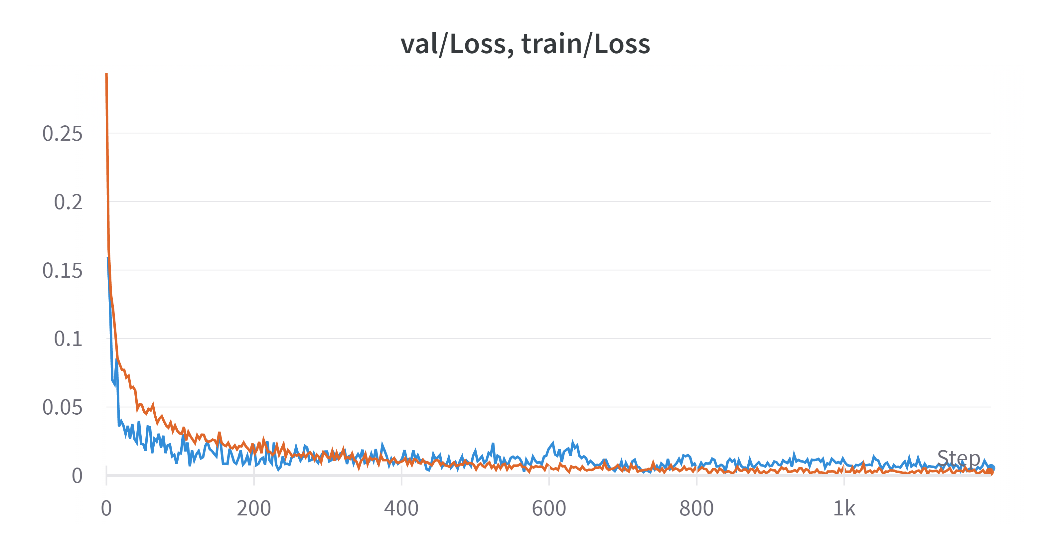
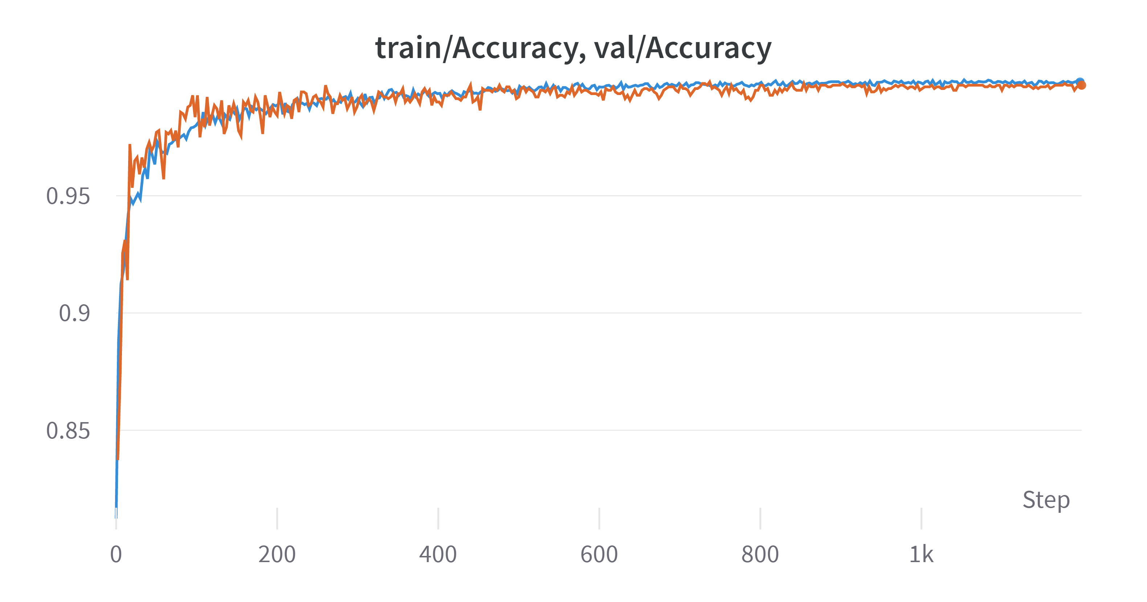
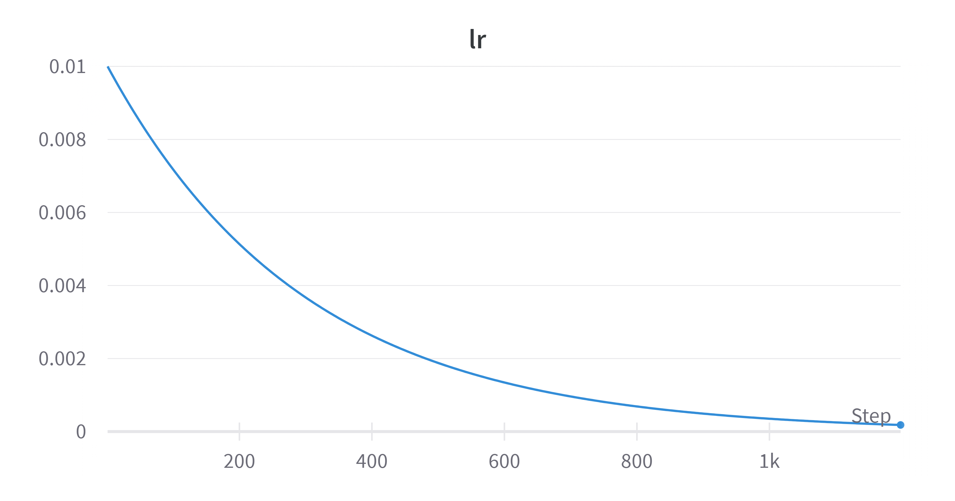
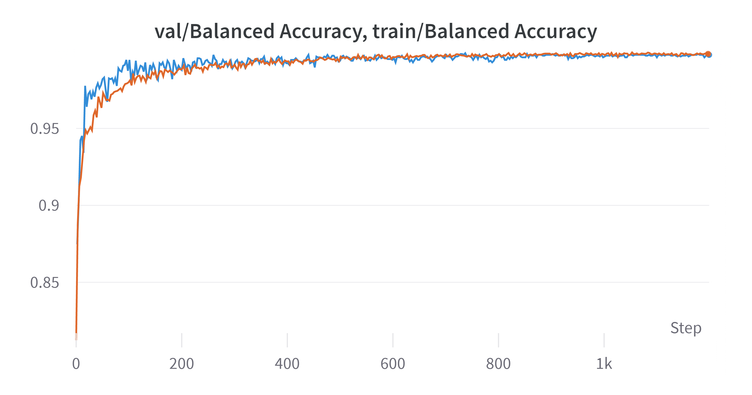
Train Results (1)
3 models were trained – ResNet18, ResNet50, ViT.
ResNet50:

Slide 10
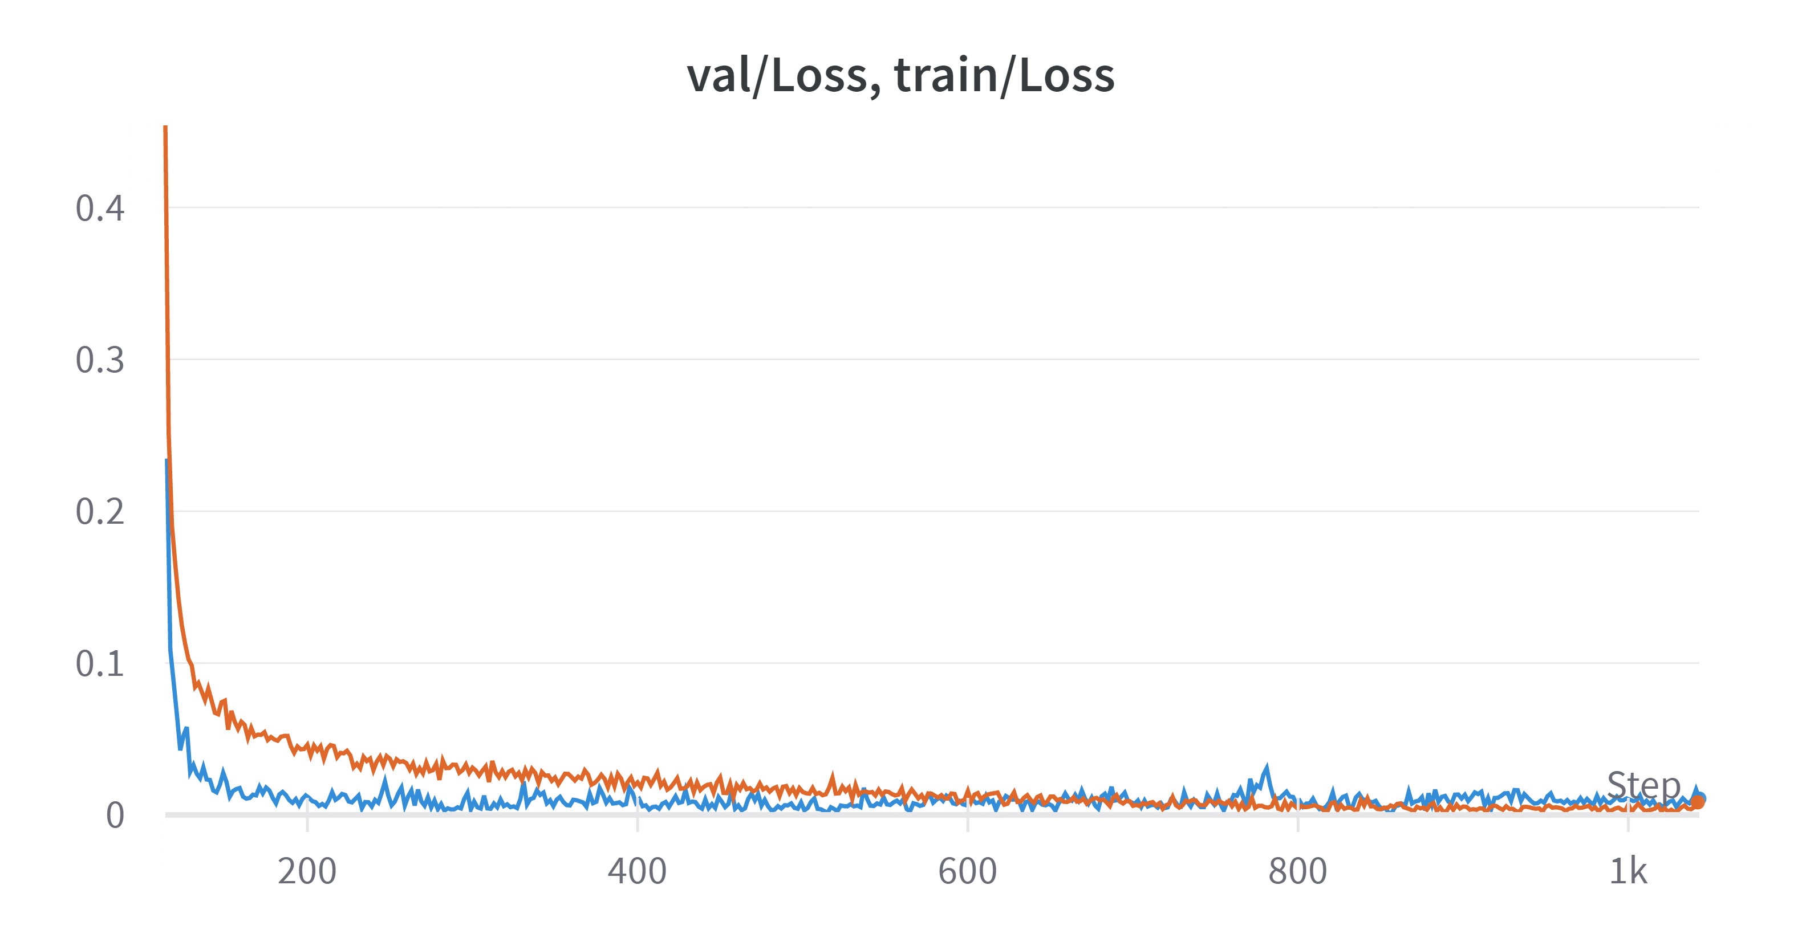
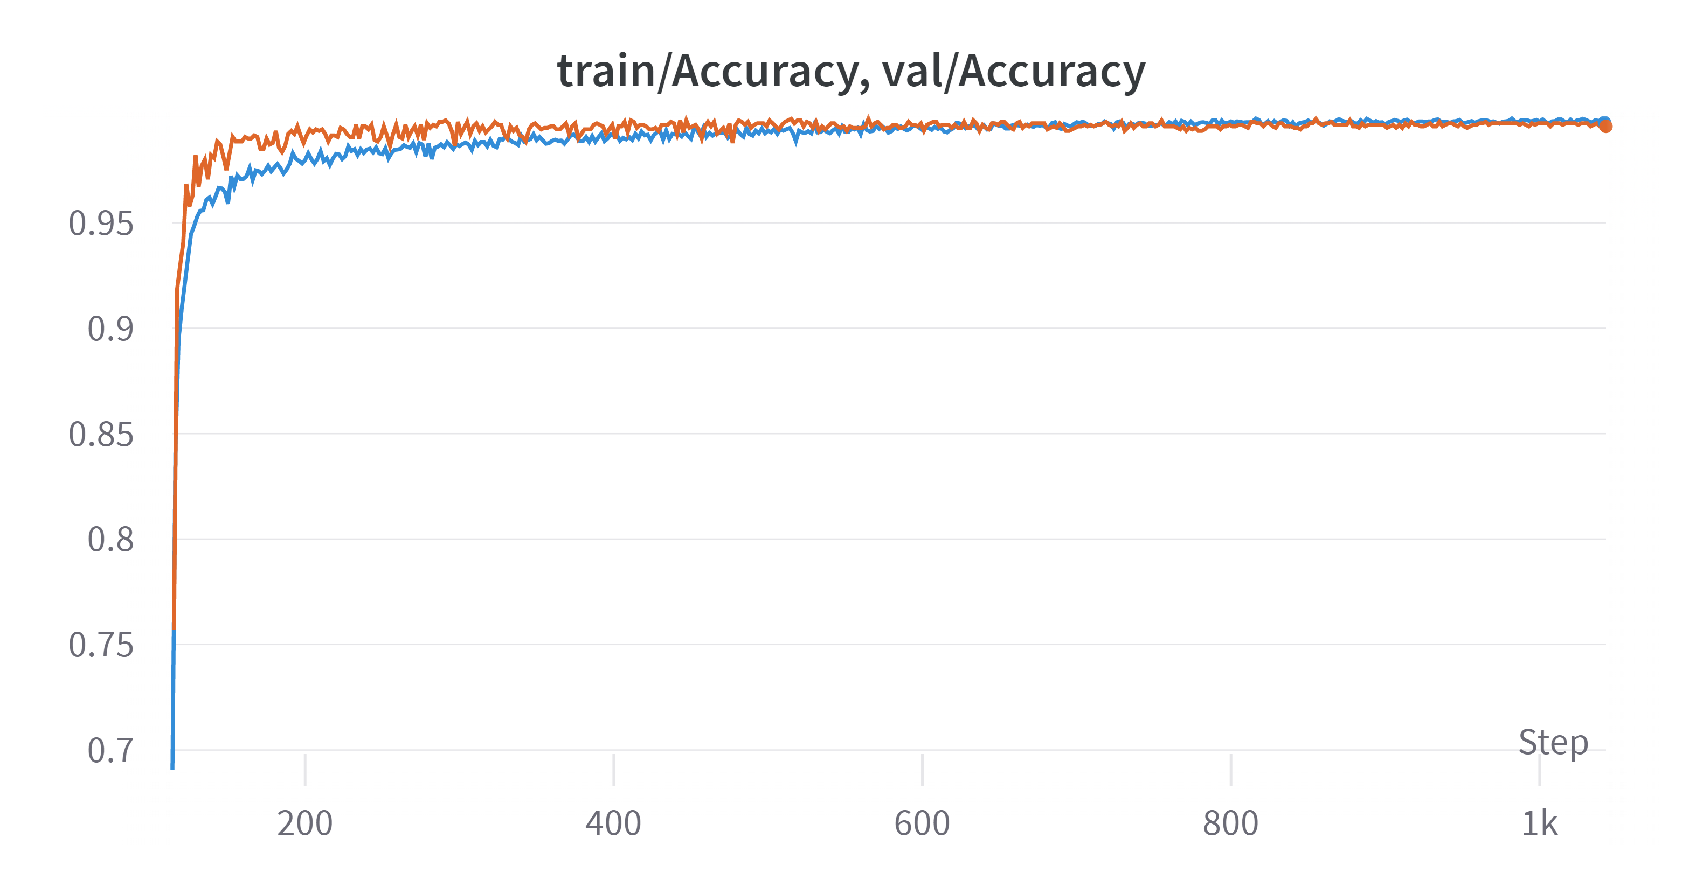
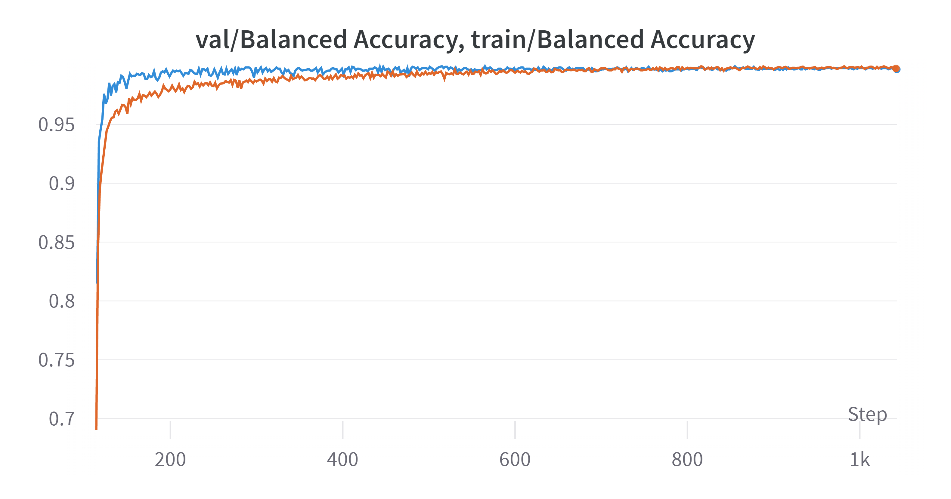
Train Results (2)
ResNet18:

Slide 11
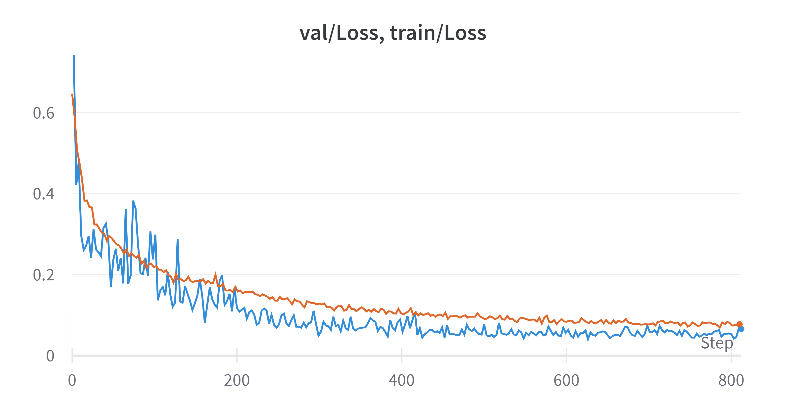
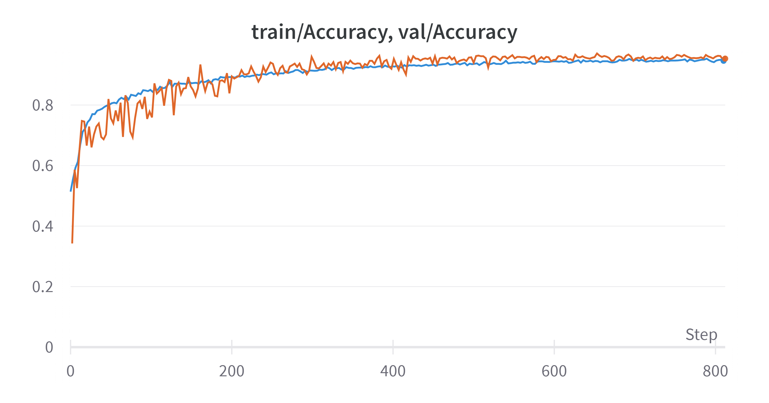
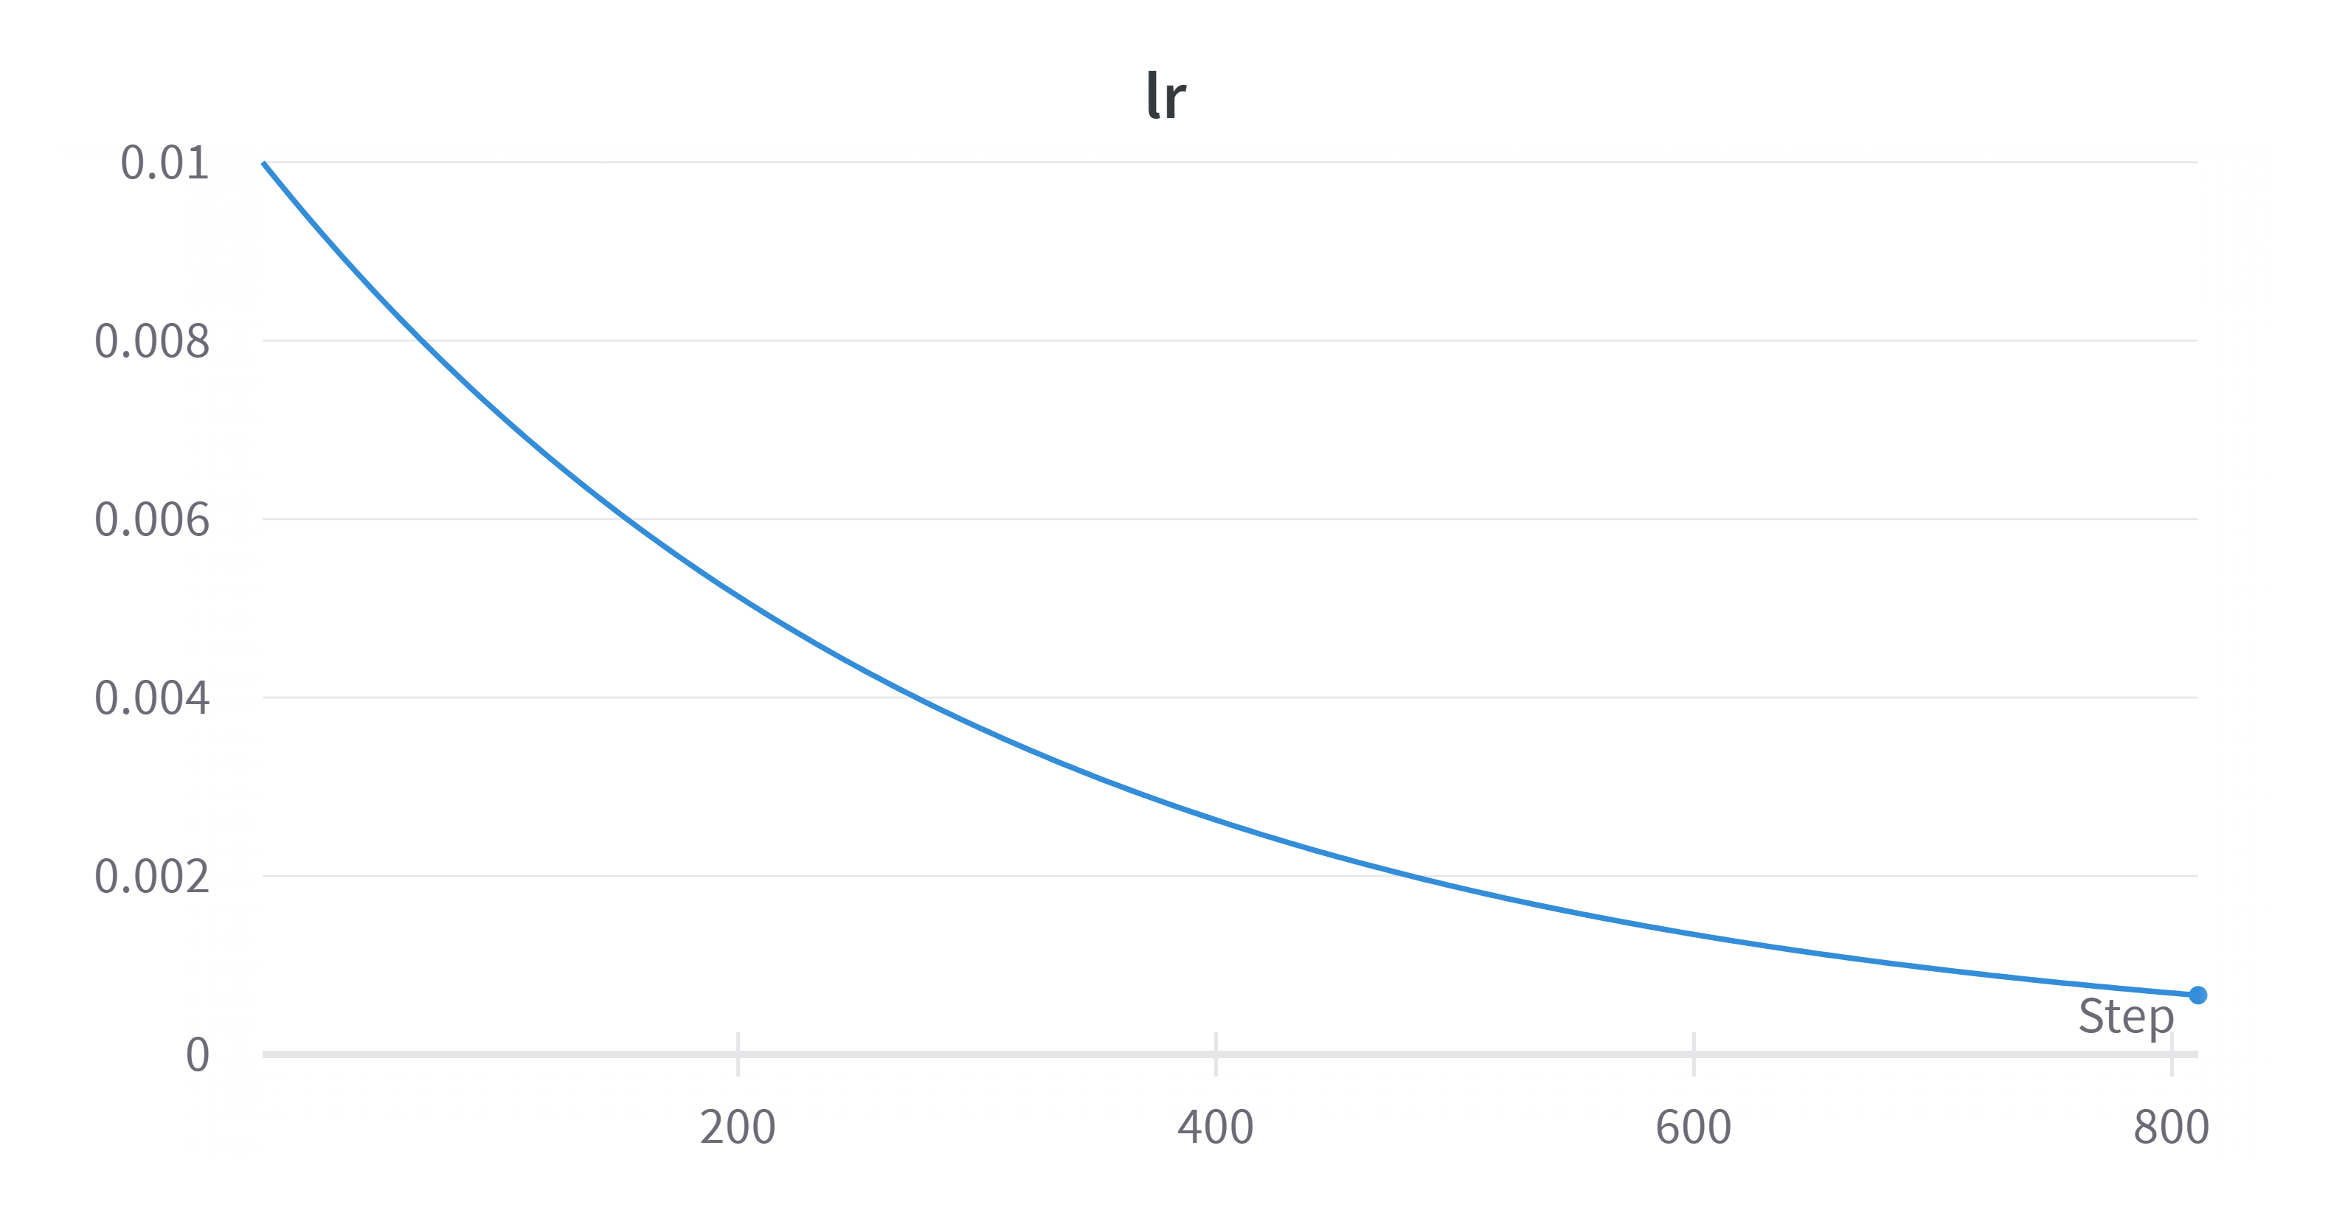
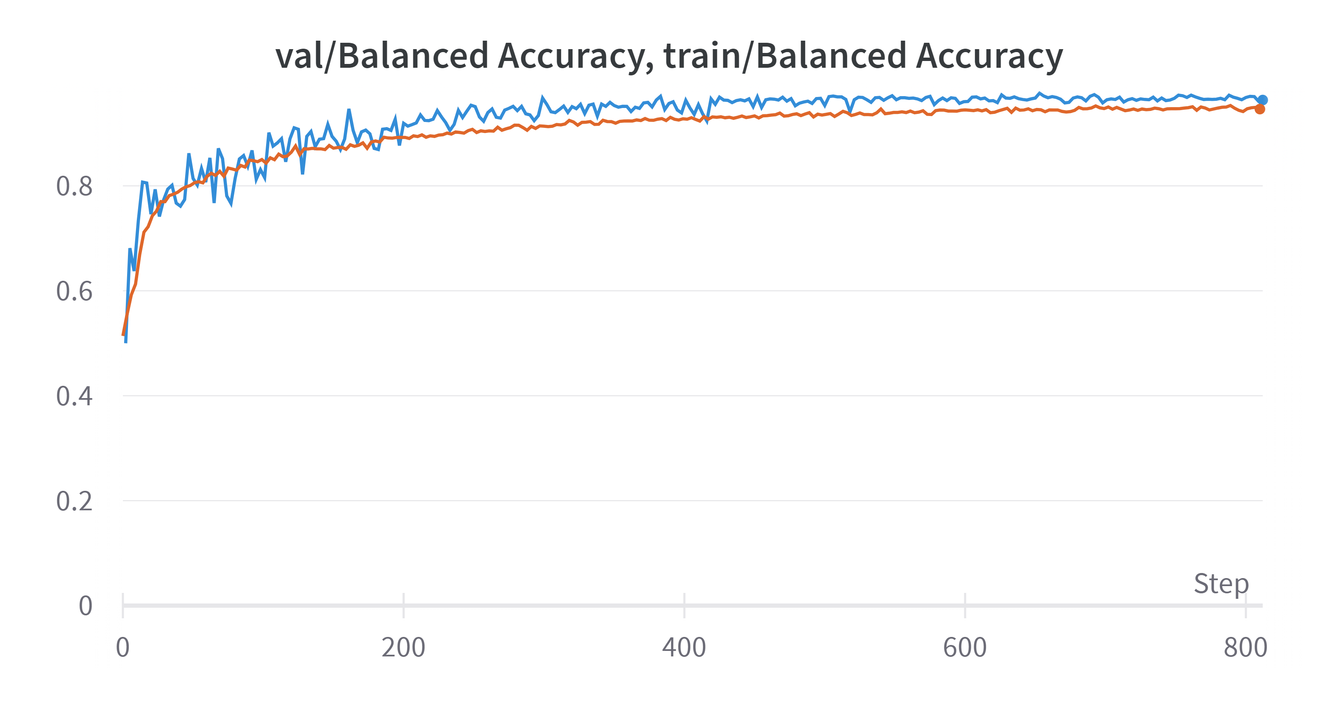
Train Results (3)
ViT:

Slide 12
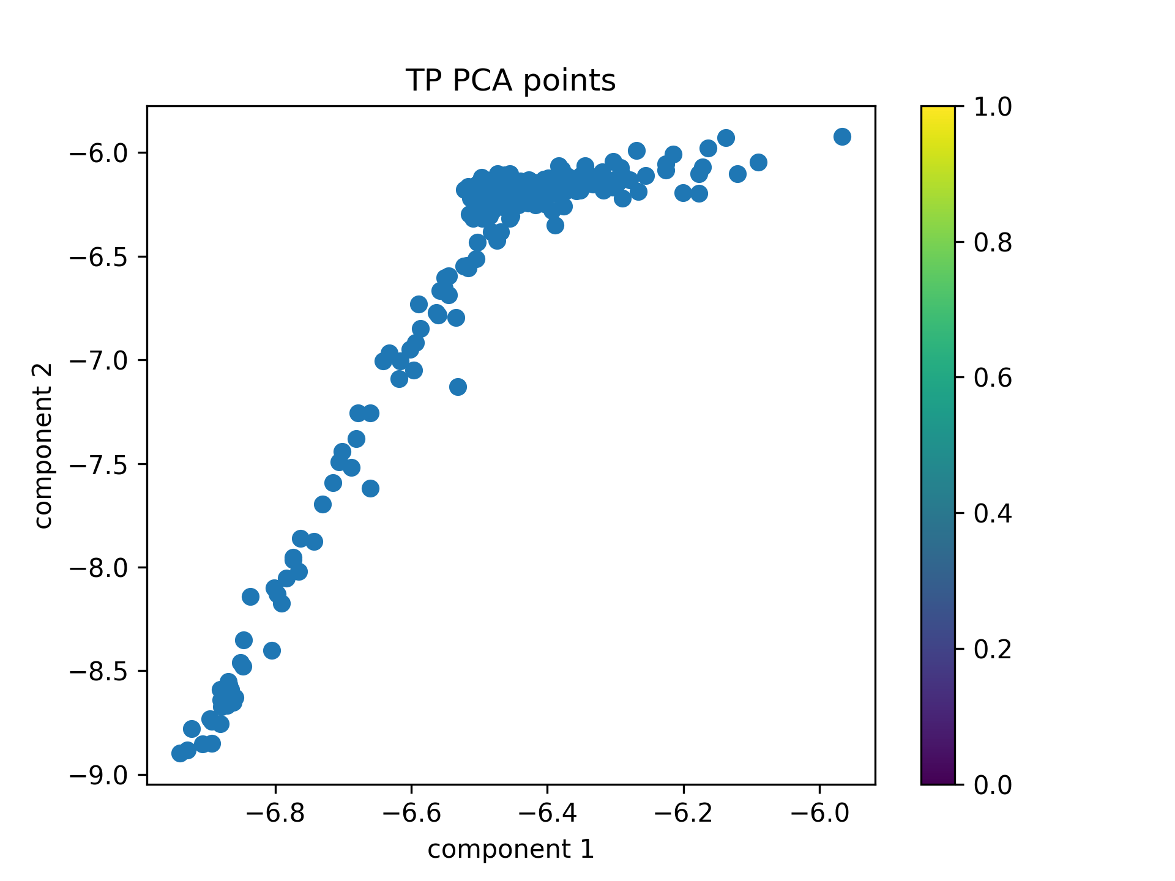
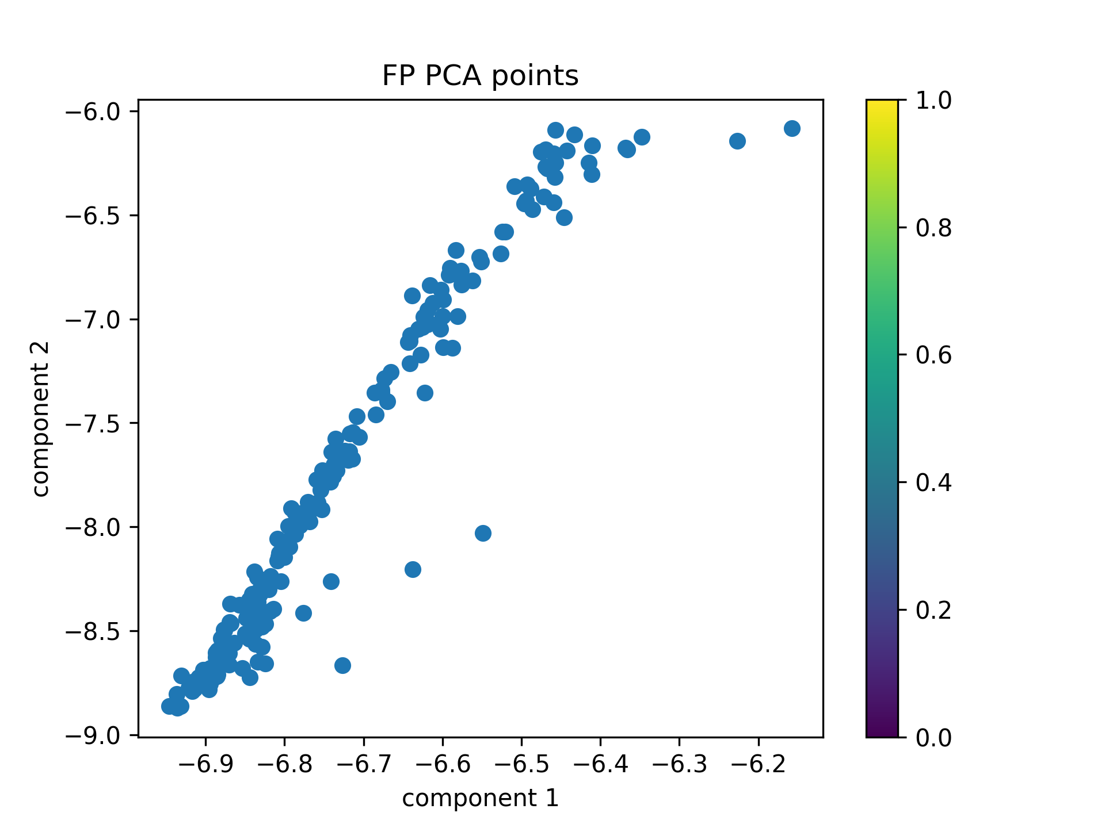


Visualization of the computed features
ResNet18, test sigmoid threshold 0.5:
I would have tried to analyze the points of the main spread in the lower left corner of the FN plot.
I assume the outliers are somehow more difficult to tackle, but it is also worth a check. Perhaps there is some pattern.
FPs are also difficult to solve because they behave similarly to TPS, but an outliers check is necessary.

Slide 13




Mis-classifications metrics
TP = 361, FP = 186, FN = 111, TN = 23388
TPR = 361 / 361+111 = 76.5%.
TNR = 23388 / 23388+186 = 99.2%.
PPV = 66%

Slide 14














Mis-classifications analysis
ResNet18, threshold 0.2:
Some FNs:
By using zoom-in and increasing blur in augmentations
we can perhaps reduce some FNs.
I did not notice smiles, nor angled faces therefore we should add this data to reduce this kind of FNs
Some FPs:
I noticed 3 types of FPs – distant faces, letters and amorphic patterns.
The amorphic patterns are perhaps easiest to deal with by some more regularization
Distant faces are incorrect therefore we should limit zoom-out augmentations, are add some distant face to the data.
We can add letters and sentences to the train set and also reduce these mistakes.

Slide 15
What would I do next
Perform mis-classification analyzation on validation-set FNs and FPs for best epoch.
Look for similarities in FNs and FPs in test-set.
Analyze outliers in PCA - in FN and FP. Also examine clusters on FNs.
Add to train set information which only exists in test-set like letters, sentences, negative examples of far faces. Positive examples of smiles and tilted faces.
Improve augmentations (to test-set FNs).
Explore architectures, models and ideas to improve results.

Slide 16
Vision Transformer

Slide 17
Appendix
Project repo on Github -
https://github.com/noamberg/face_non-face
2. W&B logs – Losses, accuracies and learning rates –
https://wandb.ai/noamberg/face_non-faces?workspace=user-noamberg
3. Trained weights -
https://drive.google.com/file/d/1emREHRBzQBTID8jmjocqqOq7S-St9BSo/view?usp=share_link

Slide 18

Thanks!

